Slide 1

Introduction to Hadoop
© Nihilent Technologies 2013

Slide 2
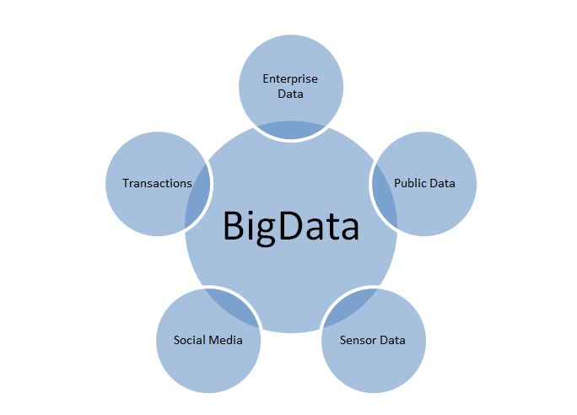
BigData : Volume, Velocity, Variety
What is BigData ?
- Twitter (over 7 TB/day )
- Facebook (over 10 TB/day)
- Google (over 20 PB/day)
- Aerial sensory technologies (remote sensing)
- Software logs, cameras(images/videos), microphones(audios)
- Radio-frequency identification readers
- Wireless sensor networks
90% of existing data in the world has been created in the last two years only.
© Nihilent Technologies 2013

Slide 3
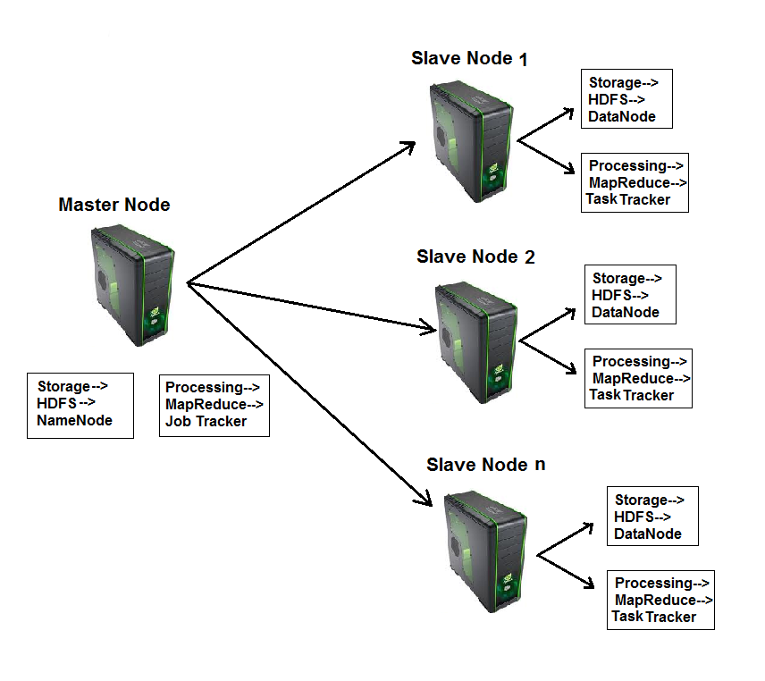
What is Hadoop?
Hadoop is a framework that facilitates functioning of several machines together to achieve the goal of storage and analyzing large sets of data.
Hadoop makes data mining, analytics, and processing of big data cheap and fast.
© Nihilent Technologies 2013

Slide 4
Components of Hadoop :
  Hadoop consists of two core components
1. The Hadoop Distributed File System(HDFS)
- HDFS is responsible for storing data on the cluster of machines.
- Data is normally split into 64MB to 128MB blocks and spread across the cluster.
2. MapReduce
      - MapReduce is data processing component of Hadoop.
      - Consist of two phases :
      1. Map
      2. Reduce
© Nihilent Technologies 2013

Slide 5
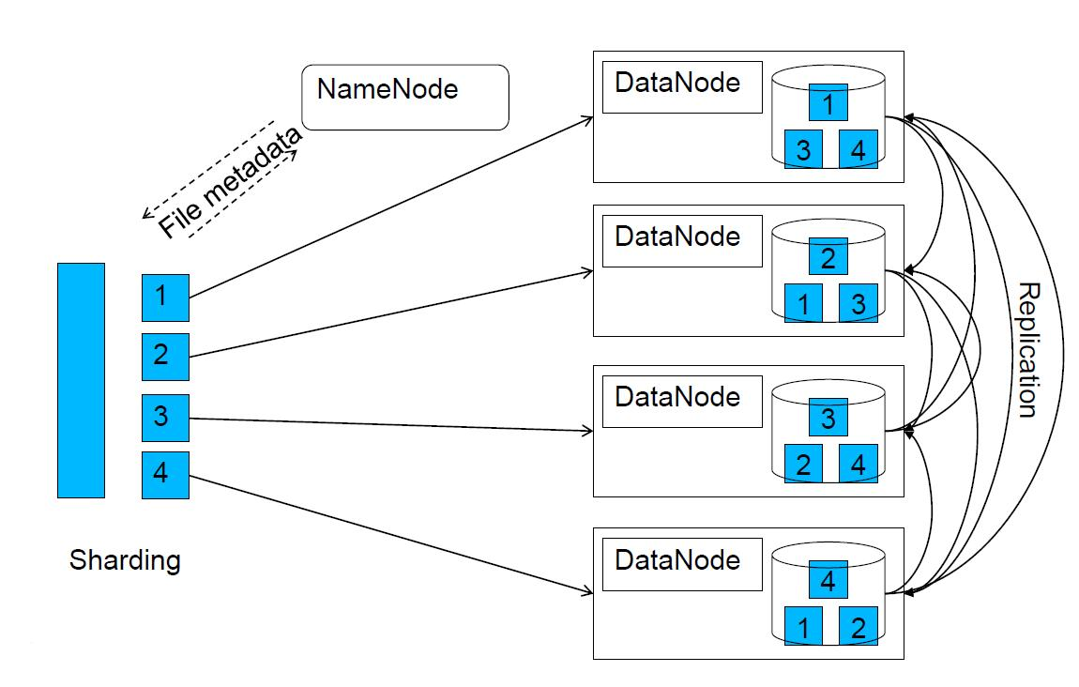
Hadoop Distributed File System(HDFS)
By default, each block(64MB to 128MB) is replicated 3 times. The replication factor can be changed through configuration settings.
© Nihilent Technologies 2013

Slide 6
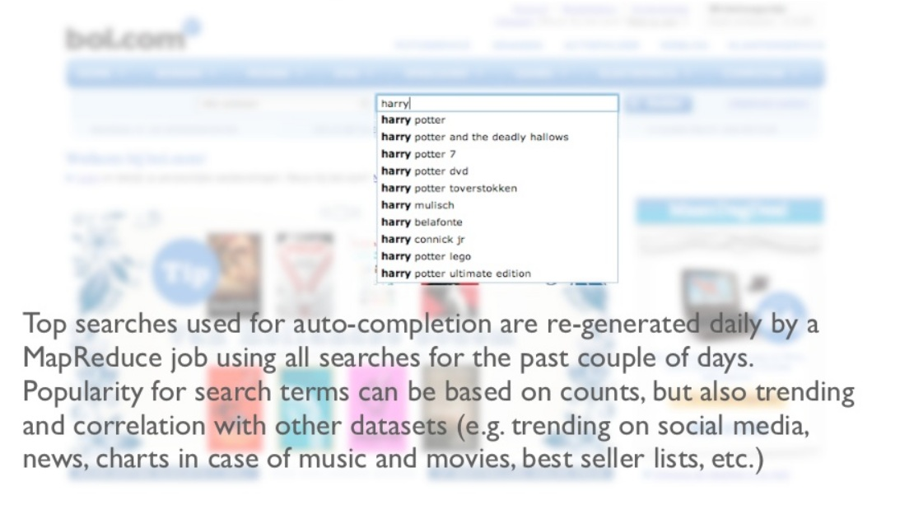
Some Real Time Examples : MapReduce
© Nihilent Technologies 2013

Slide 7
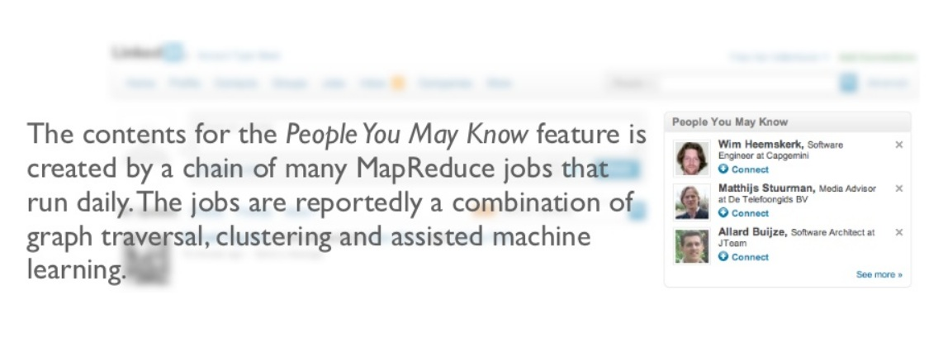
Continues…
© Nihilent Technologies 2013

Slide 8
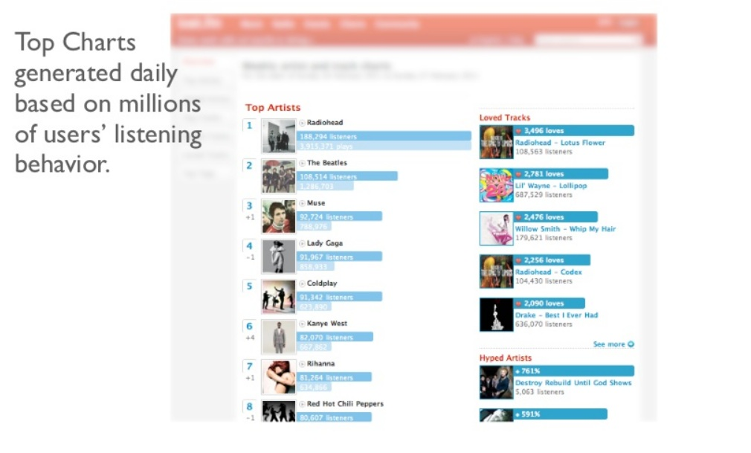
Continues…
© Nihilent Technologies 2013

Slide 9
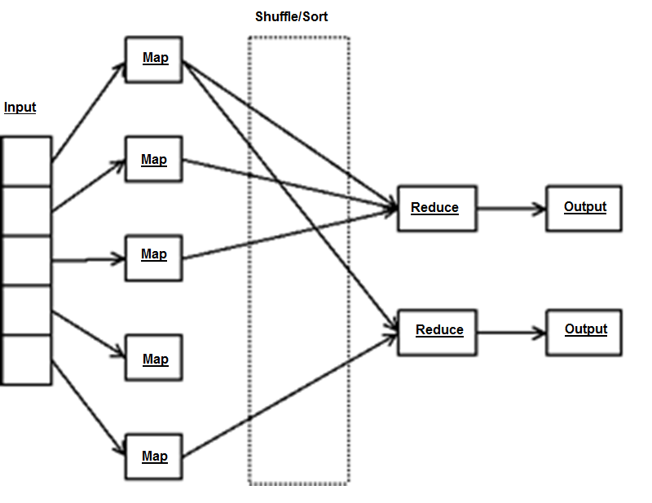
Programming Model : MapReduce
© Nihilent Technologies 2013

Slide 10
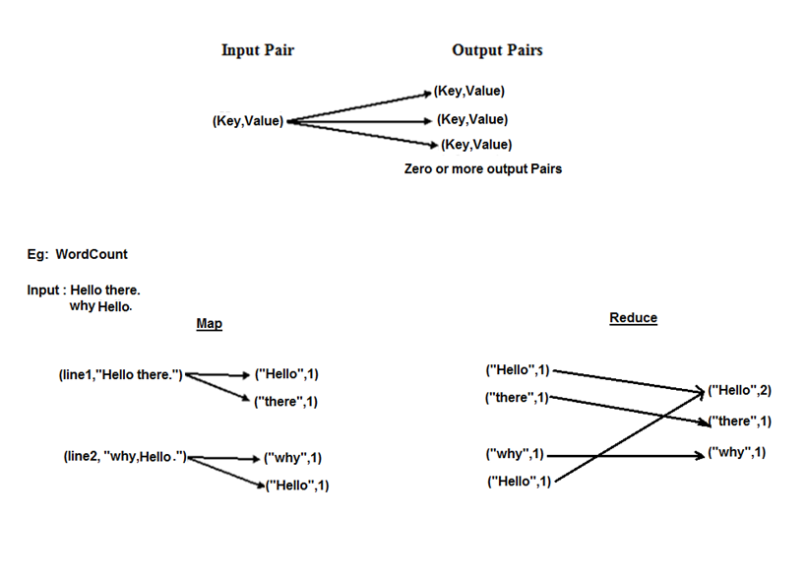
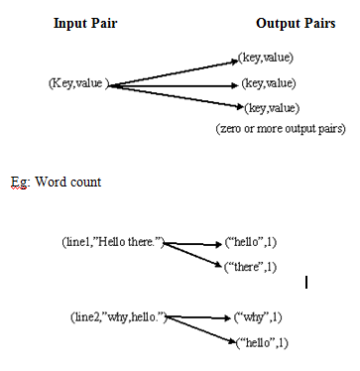
Programming Model : Key-Value Pair
© Nihilent Technologies 2013

Slide 11
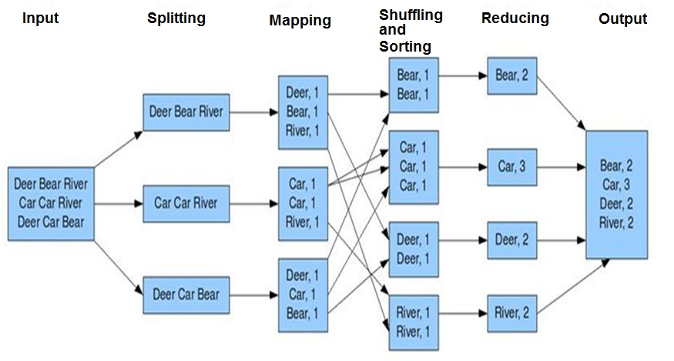
MapReduce
© Nihilent Technologies 2013

Slide 12
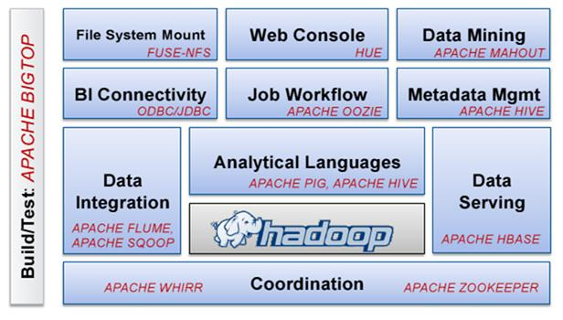
Utilities
© Nihilent Technologies 2013

Slide 13
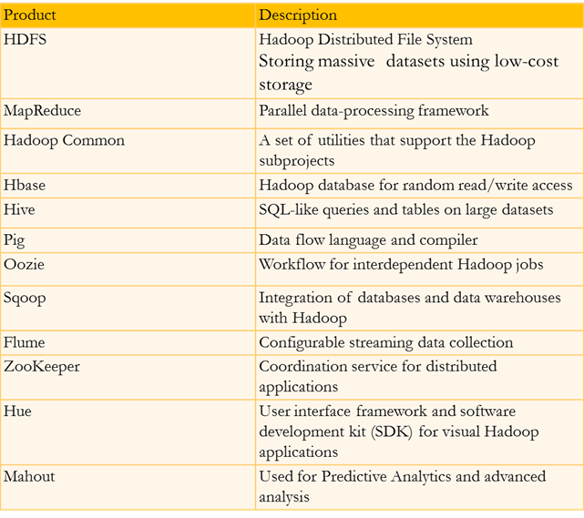
Brief description of all Utilities
© Nihilent Technologies 2013

Slide 14
Benefits of Hadoop
No huge bandwidth required.
Each node performs its task in near isolation so scaling up and down is not an issue.
Partial failure are not difficult to handle as if a node goes down, the JobTracker schedules the task on some other node without impacting the job.
© Nihilent Technologies 2013

Slide 15










Hadoop Job Processing
© Nihilent Technologies 2013

Slide 16
Demo….
Word Count example
MapReduce program
Operations through Hive
Operations through Hbase
Operation through Sqoop
© Nihilent Technologies 2013

Slide 17
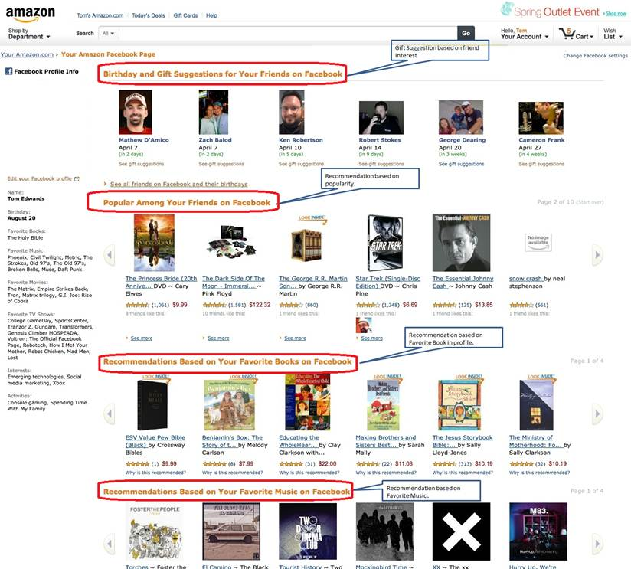
Real Time Examples: Recommendations
© Nihilent Technologies 2013

Slide 18
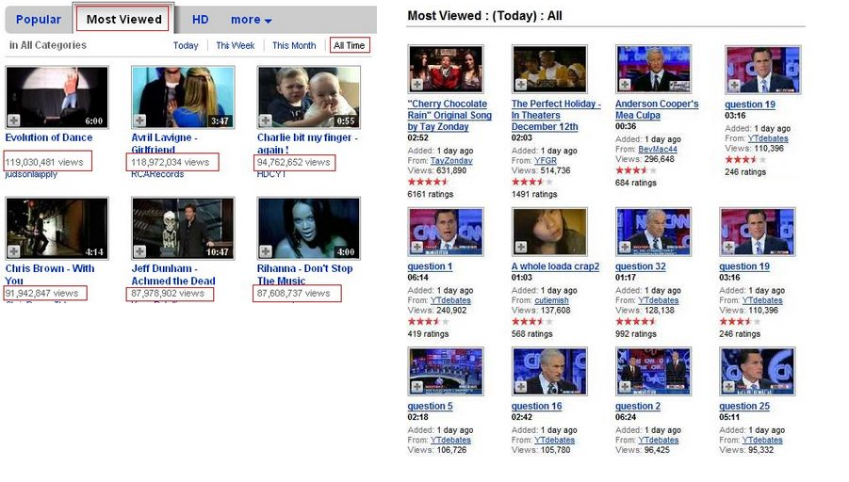
Recommendations (Continue..)
© Nihilent Technologies 2013

Slide 19

Faster Data Analysis and Reporting :
© Nihilent Technologies 2013

Slide 20

The Most Imp BigData Storage :
© Nihilent Technologies 2013

Slide 21

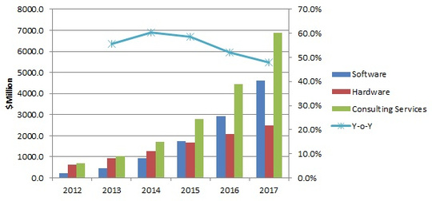
Hadoop is Growing Abnormally….
© Nihilent Technologies 2013

Slide 22
Case Studies :
How King.com uses Hadoop :
The social gaming company uses the Hadoop Distributed File System to store the data. The Hive database engine running on MapReduce is then used to structure and link the data so it can be queried, using the SQL-like language HQL (Hive Query Language). King.com also uses InfiniteDB on top of Hive to provide a low-latency querying from the fast column-oriented relational database.
Staff outside of the data warehouse use the QlikView BI Dashboard to view the results of queries made against data in the warehouse, allowing them to answer questions like ‘What’s the revenue from this country?’or ‘What’s the player experience of this particular game’, or to show the ROI for an investment in a particular marketing channel.
LinkedIn uses hadoop :
For LinkedIn, Hadoop is the power behind the “People You May Know” link and skills feature. It’s also the driver behind LinkedIn’s internal dashboards and ETL. Despite it being rather efficient and functional, LinkedIn needed to look deeper into the information, rather, better understand all of the
information gathered by Hadoop, and so, keeping it within the Elephantidae family, it created White Elephant. White Elephant is open source and freely available.
LinkedIn uses hadoop :
For LinkedIn, Hadoop is the power behind the “
© Nihilent Technologies 2013

